Slide 1



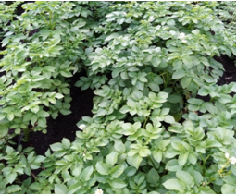
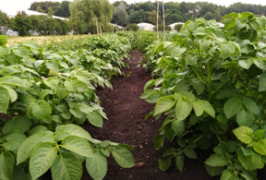
ФГБОУ ВО РГАУ-МСХА имени К.А. Тимирязева
INFLUENCE OF MICROBIOLOGICAL FERTILIZER SLAVOL ON THE FORMATION OF EARLY HARVEST OF POTATOES IN THE CONDITIONS OF THE MOSCOW REGION
M.E. Dyikanova ¹ , I.N. Gasparyan ¹,O.N. Ivashova¹, N.F. Deniskina ¹, Sh.V. Gasparyan ¹
Russian State Agrarian University - Moscow Timiryazev Agricultural Academy, 49, Timiryazevskaya street, Moscow, 127550, Russia

Slide 2
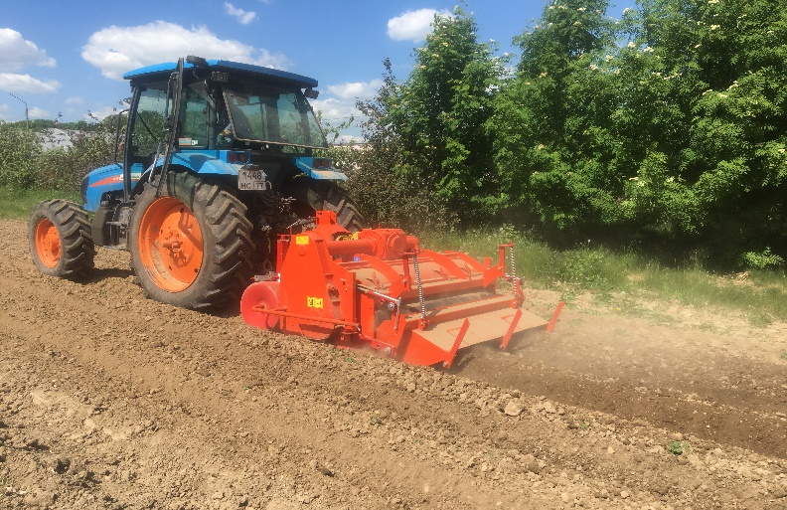
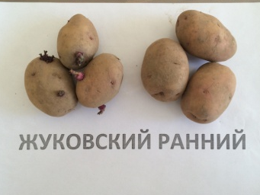
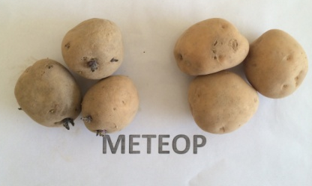
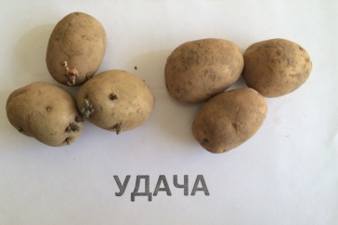
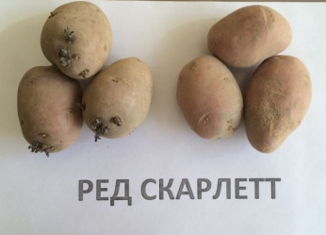
The research have studied the effect of microbiological fertilizer Slavol on the growth, development and productivity of early potatoes, such varieties as: Udacha, Bryansk delicacy, Red Scarlett, Zhukovsky early, Meteor, Riviera. Treatment with Slavol was carried out before planting, by soaking the tubers and double foliar feeding with a frequency of 10 ... 15 days.
The studies were carried out in 2020 ... 2021, on the territory of the UNPC Vegetable Experimental Station named after V.I. Edelstein.
Research options: control and treatment with microbiological fertilizer Slavol (before planting, soaking tubers for 3…4 hours in a solution concentration of 10 ml/l of water) + two foliar top dressings during the growing season with a frequency of 10…15 days.
ФГБОУ ВО РГАУ-МСХА имени К.А. Тимирязева
Research Methods

Slide 3
ФГБОУ ВО РГАУ-МСХА имени К.А. Тимирязева
Figure 1. Effect of the microbiological fertilizer Slavol on the leaf surface area of potato plants, on average for 2020…2021, per plant, in cm²

Slide 4
ФГБОУ ВО РГАУ-МСХА имени К.А. Тимирязева
Figure 2. Influence of microbiological fertilizer on the % development of early blight in early potato plants in the conditions of the Moscow region, average 2020…2021

Slide 5
ФГБОУ ВО РГАУ-МСХА имени К.А. Тимирязева
Figure 3. Effect of the microbiological fertilizer Slavol on the average mass of tubers from one plant, as of July 15 in the conditions of the Moscow Region, average 2020 ... 2022

Slide 6
ФГБОУ ВО РГАУ-МСХА имени К.А. Тимирязева
Conclusions
Thus, in the experiment, the positive effect of microbiological fertilizer Slavol on the growth, development and yield of early potato varieties in the conditions of the Moscow region was established. The use of adapted varieties in combination with modern cultivation methods makes it possible to increase the yield due to the number and average weight of tubers per plant in the early stages (July 15).
In both variants, the yield of the variety Bryansk Delicacy was not high, the average weight of one bush in the control variant was 208 grams. The treated plants of the variety Bryansk delicacy with microbiological fertilizer Slavol also had a low mass of tubers from one bush (320 grams), however, the increase in relation to the control variant of this variety was 53.8%. On average, for all varieties, when using the microbiological fertilizer Slavol, the yield increased from 22.2 to 42.8% compared to the control

Slide 7
СПАСИБО
ЗА ВНИМАНИЕ

